Slide 1
Prediction of Customer Churning in Telecom Industry
Project Mentor :
Prof. Arnab Chakraborty
Globsyn Skills
Team Members:-
1. Sandipa Bhowmick
2. Sohom Banerjee
3. Soumita Dutta
4. Souvik Datta
5. Souvik Mitra
6. Swarup Kumar Das

Slide 2
Contents
Introduction To Machine Learning
Several Ways To Implement Machine Learning Techniques
Objective of this Project
Learning/Prediction Steps
Algorithms Used
K-fold Cross Validation
Naive Bayes Classification
K Nearest Neighbors Classification
Random Forest Classification
Conclusion
References
Acknowledgement

Slide 3
Introduction to Machine Learning
Machine learning is an application of artificial intelligence that provides systems with the ability to automatically learn and improve from experience without being explicitly programmed. Machine learning focuses on the development of computer programs that can access data and use it to learn for themselves.
e.g. –
face recognition in Facebook, Google Ad sense etc.

Slide 4
Several Ways to Implement Machine Learning Techniques
Supervised Learning
Unsupervised Learning
Classification:
- Naive Bayes
- SVM (Support Vector Machine)
- Random Forest
Regression:
- Linear
- Logistic
Clustering:
K Means

Slide 5
Objective of this Project
The objective of this project is to predict customer churn. Based on the public dataset that has customer usage pattern, we have predicted whether the customer has churned or not depending on following features:
account length
international plan
voice mail plan
number of voice mail messages
total day minutes used
day calls made
total day charge
total evening minutes, etc
Target Variable: Churn: if the customer has churned (1=yes; 0 = no)

Slide 6
Learning/Prediction Steps
Get Dataset
Clean Dataset
Train Model
Test Data
Result & Accuracy
Fig. 1 (Predicting Model)

Slide 7
Algorithms Used
K- fold Cross Validation
Naive Bayes
K Nearest Neighbors
Random forest Classifier

Slide 8
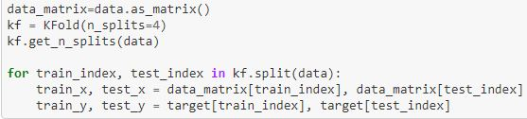
K-fold Cross Validation
K-Folds cross-validation method provides train/test indices to split data in train/test sets. It splits dataset into k consecutive folds.
Code:
Advantages:
In this method the dataset can be partitioned into separate train and test set without losing significant modelling or testing capability.
Less Noise
Disadvantages:
Computationally expensive
It represents a biased model.

Slide 9
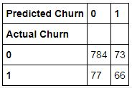

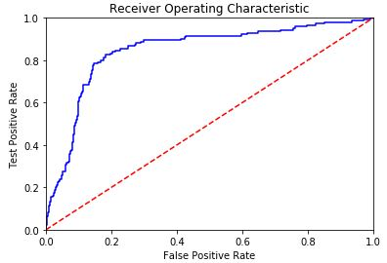
Naive Bayes
Naive Bayes methods are a set of supervised learning algorithms based on applying Bayes’ theorem.
Confusion Matrix: Accuracy:
Roc Curve:
Fig.2(ROC Curve)

Slide 10
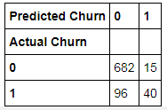

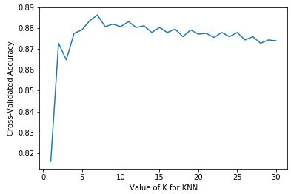
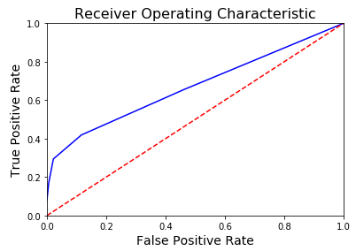
KNN(Using Library Function)
A case is classified by a majority vote of its neighbors.
Confusion matrix: Accuracy:
Roc Curve:
Fig.3 (ROC curve for Different K values)

Slide 11
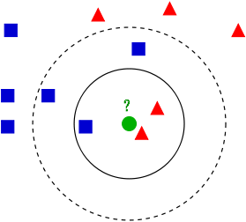
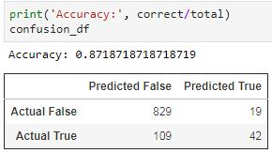
KNN Algorithm
Steps:-
Handle Data: Open the dataset from CSV and split into test/train datasets.
Similarity: Calculate the distance between two data instances.
Neighbors: Locate k most similar data instances.
Predict: Generate a response from a set of data instances.
Confusion Matrix: Compute confusion matrix to evaluate the accuracy of a classification
Accuracy: Summarize the accuracy of predictions.
Fig.4 (Example of KNN)

Slide 12
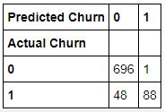
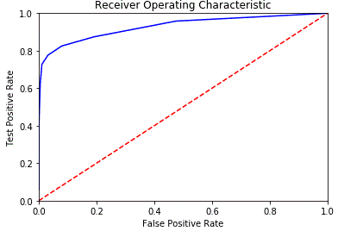
Random Forest Classification
Random forest classifier is a supervised classification algorithm. It uses decision trees to classify datasets
Confusion Matrix:
Roc Curve:
Fig.5 (ROC Curve)

Slide 13

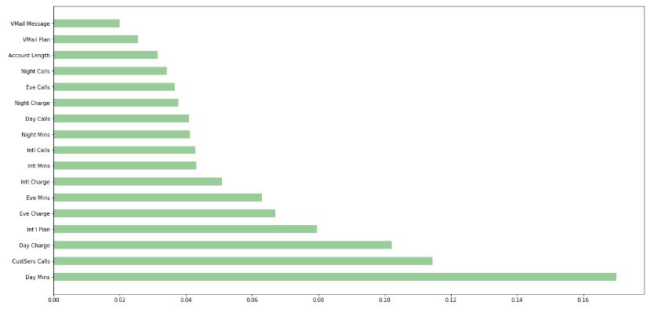
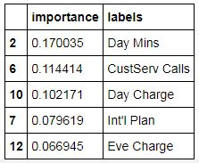
Random Forest Classification (contd.)
Accuracy:
Feature Importance:
Fig. 6 ( Feature importance plotting )

Slide 14
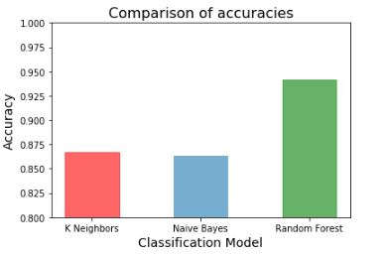
Conclusion
From the above project done, it can be concluded that the Random Forest Classifier model, is the most accurate way of predicting the customer churn score, among the three models.

Slide 15
References
http://ieeexplore.ieee.org/document/7570883/figures
https://github.com/bensadeghi/pyspark-churn-prediction/blob/master/data/churn-bigml-80.csv
https://github.com/bensadeghi/pyspark-churn-prediction/blob/master/churn-prediction.ipynb
https://github.com/navdeep-G/customer-churn/blob/master/data/TelcoChurn.csv
https://campus.datacamp.com/courses/cleaning-data-in-python
https://qxf2.com/blog/cleaning-data-python-pandas/
https://www.coursera.org/learn/machine-learning
https://www.crowdanalytix.com/contests/why-customer-churn
http://ieeexplore.ieee.org/document/7570883/figures

Slide 16
Acknowledgement
We are very grateful to Our Respected teacher for proper guidance and support to make this presentation successful.

Slide 17
Thank You…

